Slide 1
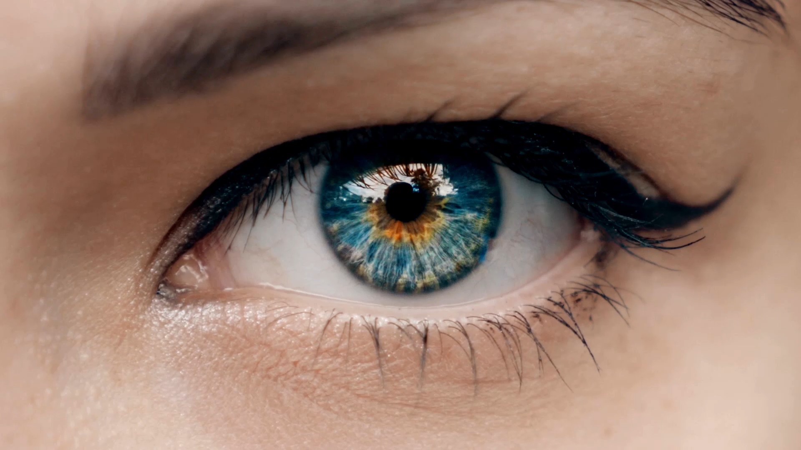
Third eye
....because we all have the same problem, and only some of us see it.
Some people call these once disabled... but really :
they are just people with a different point of view!

Slide 2
My grandmother often said:
"If you don't have what you want, you should appreciate what you have."
However, sometimes we fail to recognize what is nearly within our reach because it’s hidden or unclear,
besides - I don't like the phrase "you should"
This is where the concept of the "Third Eye" becomes important—to help us uncover and attain exactly what we desire.

Slide 3
How does this solution differ from other options available online, such as Google Live View?

Slide 4
The simplest explanation :
Third Eye — is interactive: it reacts with buildings and their employees and doesn’t scan the whole world, only the place where we are. The answers aren’t virtual but real — only powered-on devices respond, and only those within whose range we are.
This solution could also be called:
a last-mile search engine
— where completely different things matter — where the entrance is, where the available parking spaces are, where to eat at the place I’ve ended up — where there is a free table, whether someone from the municipal office can come out and help me get inside – in a case i need it etc.

Slide 5

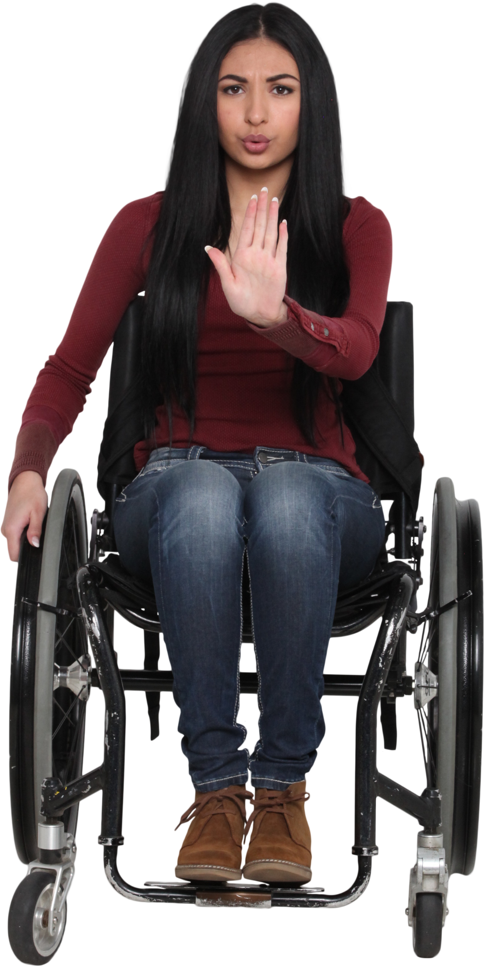
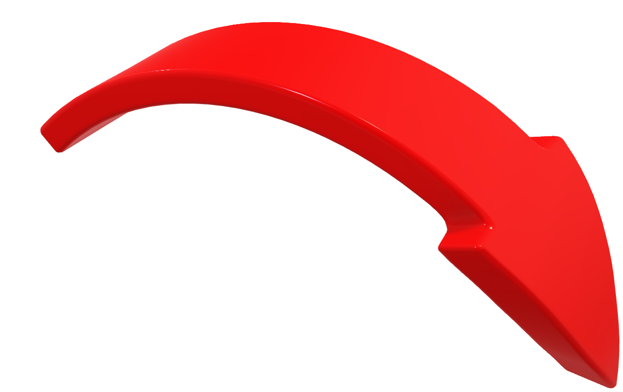
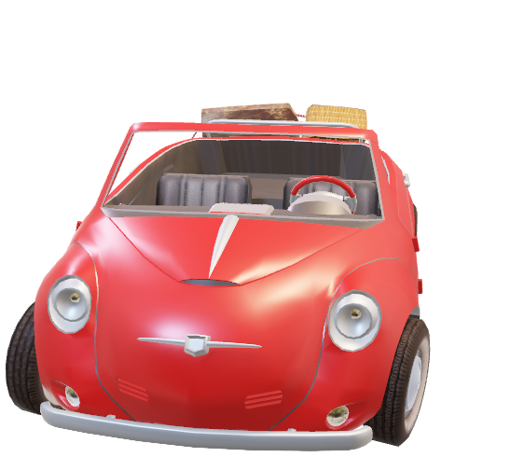
And a bit more broadly:
The third eye is like - an additional sense that can communicate with intelligent buildings within a 10km radius. On the service provider's side, for example: municipal office, parking lot, gas station, store, hotel, restaurant, etc. - another radio device - terminal - responds directly to the signal transmitter. In case of need for interaction from the service provider - an information appears on the terminal screen - that for example "Mr./Ms. Muster is standing at fuel dispenser No. 3 and waiting for help with refueling" - the operator - in this case the gas station employee - provides the number of minutes after which they can help Ms. Muster - and the information reaches the "Third eye" connected to the phone. Similarly, you can reserve a table in a restaurant, find a free parking space, pick up prepared purchases from the store... etc.

Slide 6


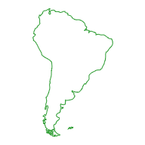
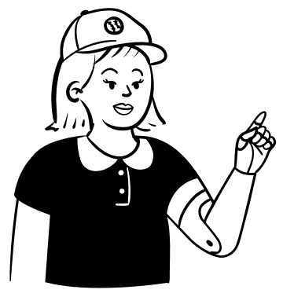




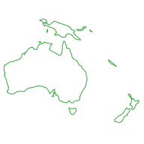




Third eye
other solutions
Problem to solve:
browser
Serching engin
Serchning algorytm
All word
Theoretically available solution
Immediate neighborhood
Direct answer

Slide 7
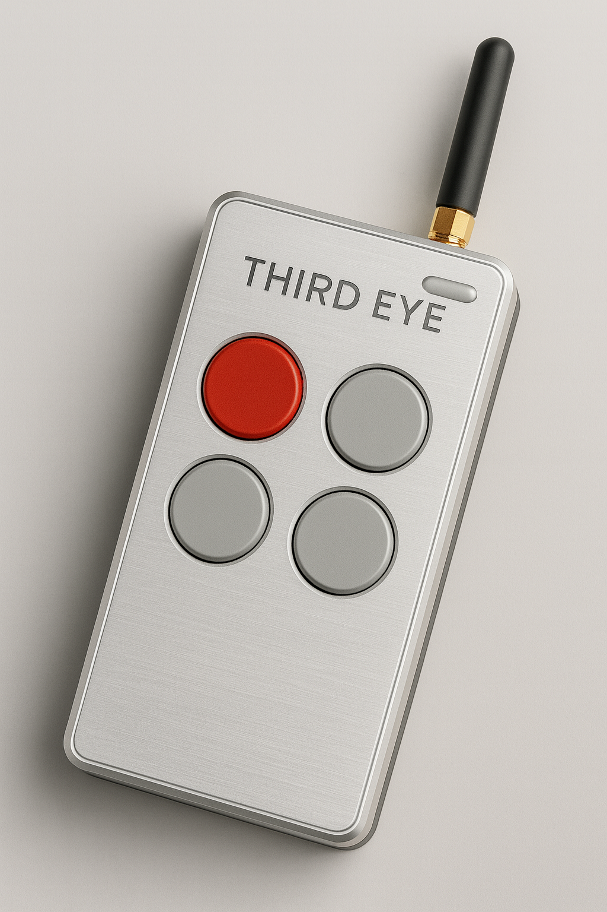
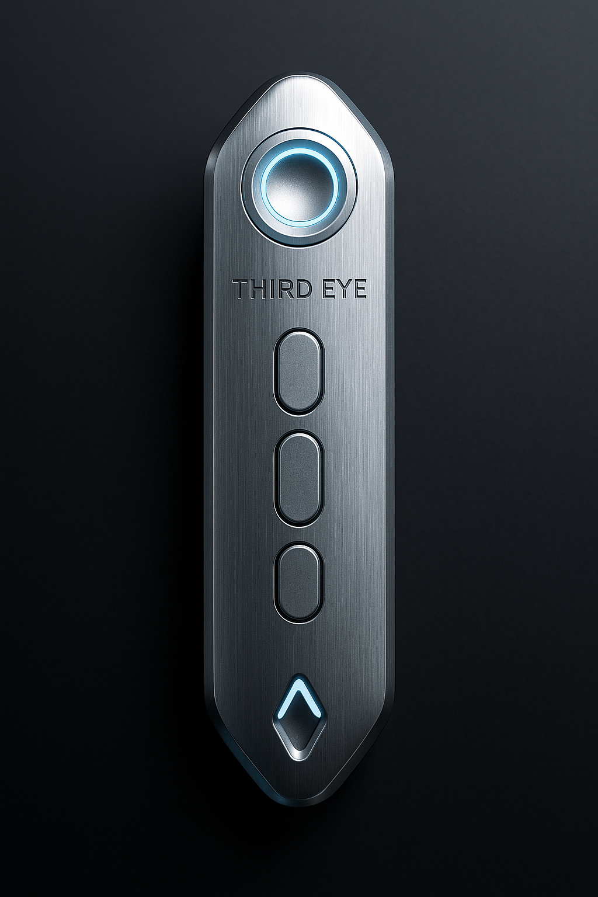
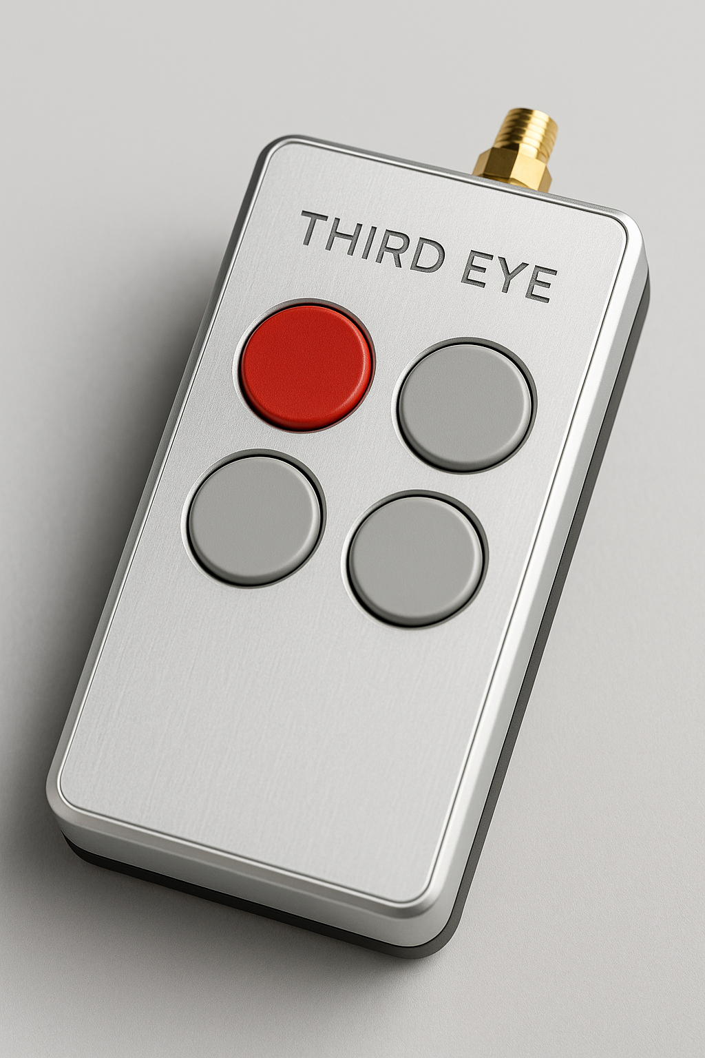
Proposed aesthetics of the devices

Slide 8
THIRD EYE
Because we all face the same challenge — only some of us can see it clearly.
Each of us, regardless of fitness, sometimes loses orientation.
We can't see the entrance to the building, we don't know where the staff is,
we can't find the right information exactly when we need it.
For people with limited mobility, this is everyday life.
For the rest - a temporary inconvenience.
Third Eye was born out of this difference.
It's a small, elegant device the size of a garage remote control,
that "opens up the second layer of the world" - information, help and services
hidden within a radius of up to 10 km.
And all this not thanks to the application or maps,
but thanks to a network of local points (LoRa), partners and devices,
that see what the human eye cannot see.
Third Eye helps us see what is already there - just hidden.

Slide 9
What does this change for the terminal operator - the entrepreneur :
1. his prestige increases
2. he is freed from the slavery of influencers
3. the information reaching the customer is up-to-date
4. the group of people counted as customers is near the entrance doors, which increases the probability of advertising effectiveness

Slide 10



Someone among you watching these slides will probably say: "why another remote in my pocket - I already have too many"... but I never said it has to be another remote - the Third eye can successfully, thanks to the use of appropriate radio chips and additional memory, replace existing remotes and be ready to clone subsequent radio-controlled devices appearing in the home - from the phone you select e.g. Open garage door, turn off the light in the kitchen, raise the blind in the living room and on the remote the red button - "execute" ....

Slide 11
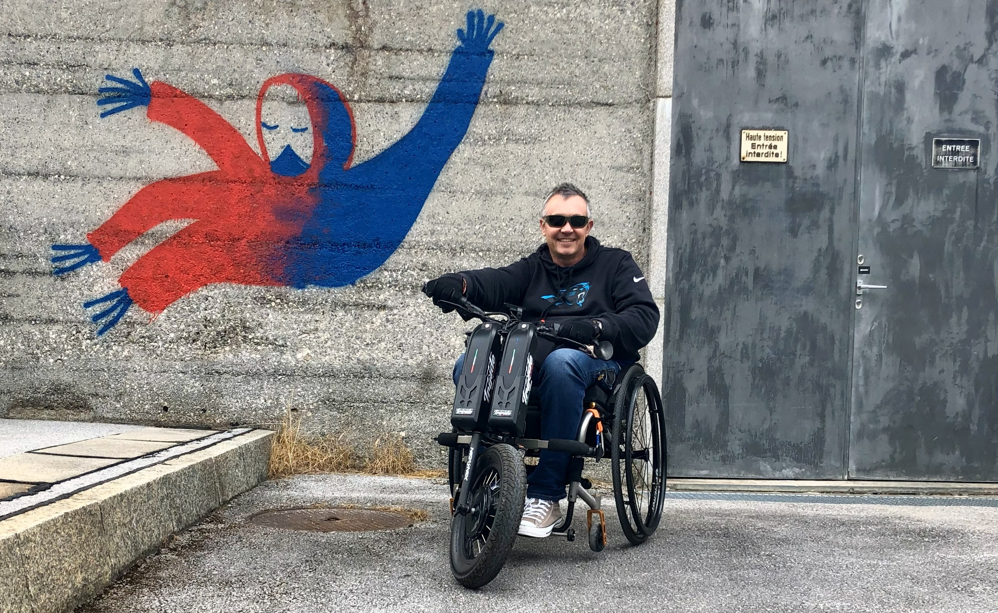
Why am I doing this?
I have been using a wheelchair for several years.
It changed my life - but it didn't take away what I love:
technology, radiocommunication, problem solving.
However, I have noticed that everyday life is not about physical obstacles.
The hardest thing is what you can't see:
where is the entrance,
where can I park
who can help
how to get to a store or gas station,
where am I when the GPS loses signal in a canyon of streets.
Third Eye was created because I wanted to solve the simplest,
and at the same time the most common question:
"Where am I and who can help me - here and now?"

Slide 12

Contact
Jarosław Starke
Phone +41 79 789 32 15
Email jarek.starke@gmail.com

